Slide 1

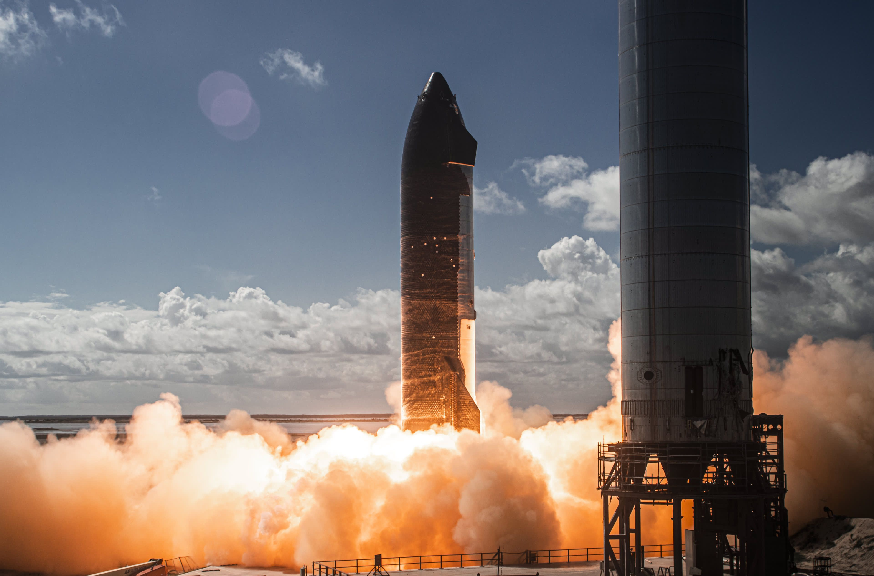
Predictive Analysis on SpaceX First Stage Reuse
Kalyan Kumar Reddy
06/02/2025

Slide 2
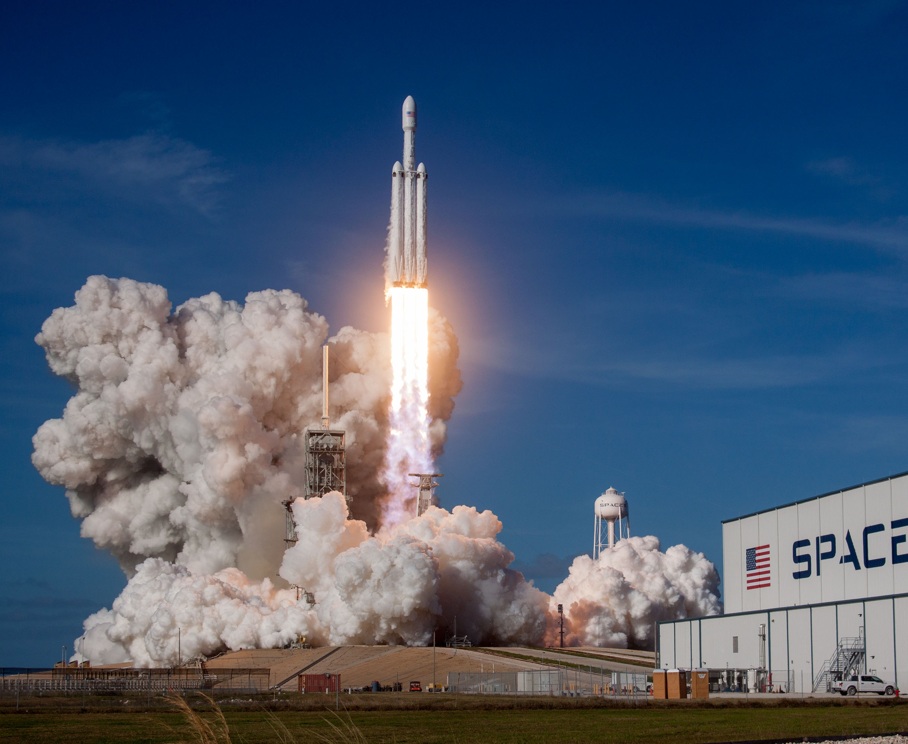
Content
Executive Summary
Introduction
Methodology
Results
EAD with Visualization
EAD with SQL
Interactive Maps with Folium
Plotly Dashboards
Predictive Analysis
Conclusion

Slide 3
Executive Summary
This research is attempts to identify the factors for a predicting weather the first stage of Space X rocket is reusable or not. To make this determination, the following methodologies where used:
Collect data using SpaceX REST API and web scraping techniques
Wrangle data to create success/fail outcome variable
Explore data with data visualization techniques, considering the following factors: payload, launch site, flight number and yearly trend
Analyze the data with SQL, calculating the following statistics: total payload, payload range for successful launches, and total # of successful and failed outcomes •
Explore launch site success rates and proximity to geographical markers
Visualize the launch sites with the most success and successful payload ranges
Build Models to predict landing outcomes using logistic regression, support vector machine (SVM), decision tree and K -nearest neighbor (KNN

Slide 4
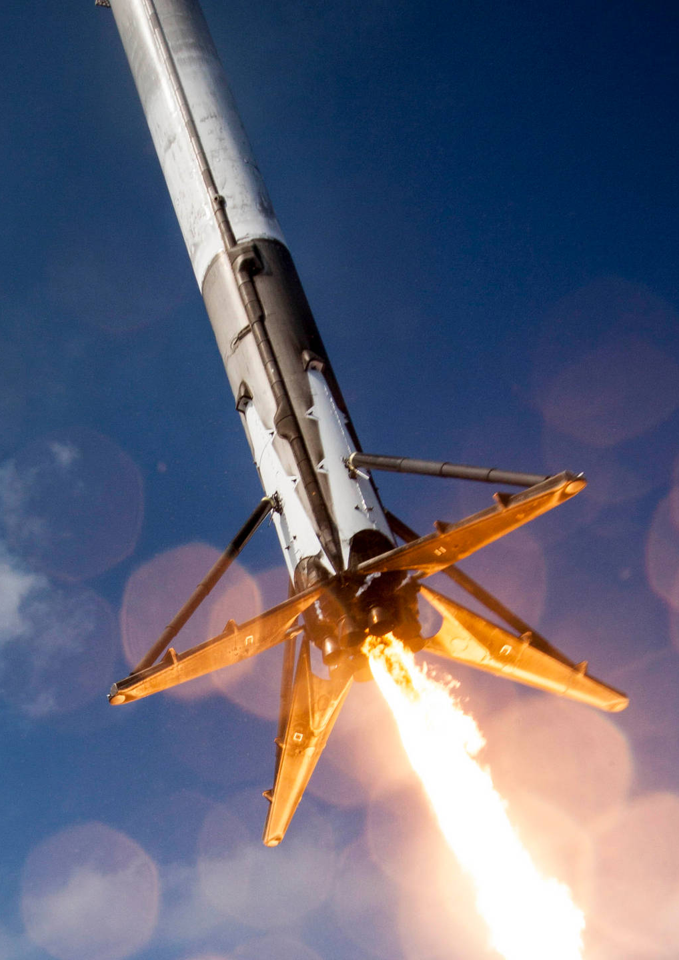
Introduction
Here, we'll predict if the Falcon 9's first stage will land safely. Due in large part to SpaceX's ability to reuse the first stage, the company advertises Falcon 9 rocket launches on its website for 62 million dollars, whereas other companies charge up to 165 million dollars per. Thus, we can calculate the launch cost if we can predict whether the first stage will land. If a different business want to bid against SpaceX for a rocket launch, they can utilize this information.

Slide 5
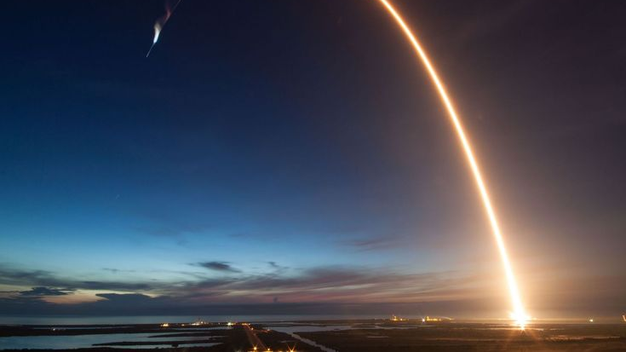
Methodology

Slide 6
Steps Involved in Methodology
Collect data using SpaceX REST API and web scraping techniques
Data Wrangling – by filtering the data, handling missing values and applying one hot encoding – to prepare the data for analysis and modeling
EDA with SQL and data visualization techniques
Visualize the data using Folium and Plotly Dash
Build Models to predict landing outcomes using classification models. Tune and evaluate models to find best model and parameters

Slide 7
Data Collection - API
Steps Followed to Prepare the Dataset
Accessed SpaceX API ‣ Retrieved rocket launch data via SpaceX's public API.
Parsed and Flattened JSON Response ‣ Used .json() and json_normalize() to convert nested API responses into a tabular format.
Custom Data Extraction ‣ Built custom Python functions to fetch and extract relevant launch data.
Structured the Data ‣ Created a dictionary from the extracted data and converted it into a Pandas Data Frame.
Filtered for Falcon 9 Launches Only ‣ Isolated data to include only Falcon 9 missions for focused analysis.
Handled Missing Values ‣ Replaced null values in Payload Mass using the column mean for consistency.
Saved for Further Analysis ‣ Exported the cleaned dataset to a CSV file for modeling and exploration.

Slide 8
Data Collection Via Web Scraping
Steps Followed to Extract Falcon 9 Launch Data from Wikipedia
Requested Falcon 9 Launch Data ‣ Sent HTTP request to the relevant Wikipedia page containing launch records.
Parsed HTML Content ‣ Created a BeautifulSoup object to navigate the HTML structure.
Extracted Table Headers ‣ Identified and extracted column names from the table's <thead> section.
Parsed Table Rows ‣ Iterated through HTML <tbody> rows to collect launch-specific data.
Structured the Data ‣ Built a dictionary from the parsed data for clean tabular representation.
Created DataFrame ‣ Converted the dictionary into a Pandas DataFrame for analysis and Exporting to CSV

Slide 9

Data Wrangling
Steps involved in Data Wrangling
Dropped irrelevant columns (e.g., images, links)
Renamed columns for clarity and consistency
Converted data types (e.g., date, numeric fields)
Handled missing values using mean or row removal
Created new column: FirstStageLandingSuccess (1 or 0)
Filtered dataset to include only Falcon 9 launches
Exported cleaned dataset to CSV for analysis

Slide 10
EDA with Visualization
Insights from Visual Analysis
Scatter plots reveal potential relationships useful for predictive modeling.
Bar charts expose categorical impact on payload and launch success.
EDA helps uncover key features influencing first-stage reusability.
Scatter Plots – Identify Patterns & Trends
Flight Number vs. Payload Mass (kg): ‣ Reveals trends in payload mass across missions and how it evolved over time.
Payload Mass vs. Orbit Type: ‣ Shows if certain orbits demand heavier payloads — may influence reusability.
Scatter Plot – Spatial Launch Analysis
Flight Number vs. Launch Site: ‣ Highlights frequency and sequence of launches per site.
Bar Charts – Category Comparisons
Payload Mass vs. Launch Site: ‣ Compares how launch sites handle varying payload capacities.

Slide 11

EDA with SQL
Identified all unique launch sites used in SpaceX missions
Filtered launch sites that start with “CCA” for focused analysis
Calculated total payload mass carried by boosters for NASA missions
Computed average payload mass for Falcon 9 v1.1 booster version
Retrieved date of the first successful landing on a ground pad
Listed boosters with successful drone ship landings and payload mass between 4000 and 6000 kg

Slide 12
Interactive Map with Folium
Visual Exploration of Launch Sites
Plotted a blue marker at NASA Johnson Space Center with popup label using latitude & longitude
Plotted red markers at all launch sites with their names as interactive popups
Displayed colored markers for launch outcomes: ‣ Green for successful launches ‣ Red for unsuccessful launches
Distance Analysis to Nearby Infrastructure
Drew lines from CCAFS SLC-40 to its nearest: ‣ Coastline ‣ Railway ‣ Highway ‣ City center

Slide 13
Build Dashboards with Potly Dash
User-Driven Data Exploration
Dropdown Selector for Launch Sites ‣ Enables selection of all sites or a specific launch site for customized views
Payload Mass Range Slider ‣ Allows filtering of data by adjustable payload mass range
Visual Insights
Pie Chart of Launch Outcomes ‣ Displays proportion of successful vs. unsuccessful launches
Scatter Plot: Payload Mass vs. Launch Success ‣ Visualizes correlation between payload size and success rate ‣ Colored by booster version for deeper comparison

Slide 14
Predictive Analysis
Objective
Predict whether the first stage of a SpaceX Falcon 9 rocket is reusable or not based on launch characteristics.
Approach
Feature Selection ‣ Selected key variables: Payload Mass, Launch Site, Orbit Type, Booster Version, Landing Outcome
Data Preprocessing ‣ Encoded categorical variables ‣ Normalized numerical features ‣ Handled missing values
Model Training & Evaluation ‣ Used classification models like Logistic Regression, SVM, Decision Tree, and KNN ‣ Evaluated performance using accuracy, precision, recall, F1-score
Best Model Selection ‣ Identified the model with the highest accuracy for predicting reusability

Slide 15
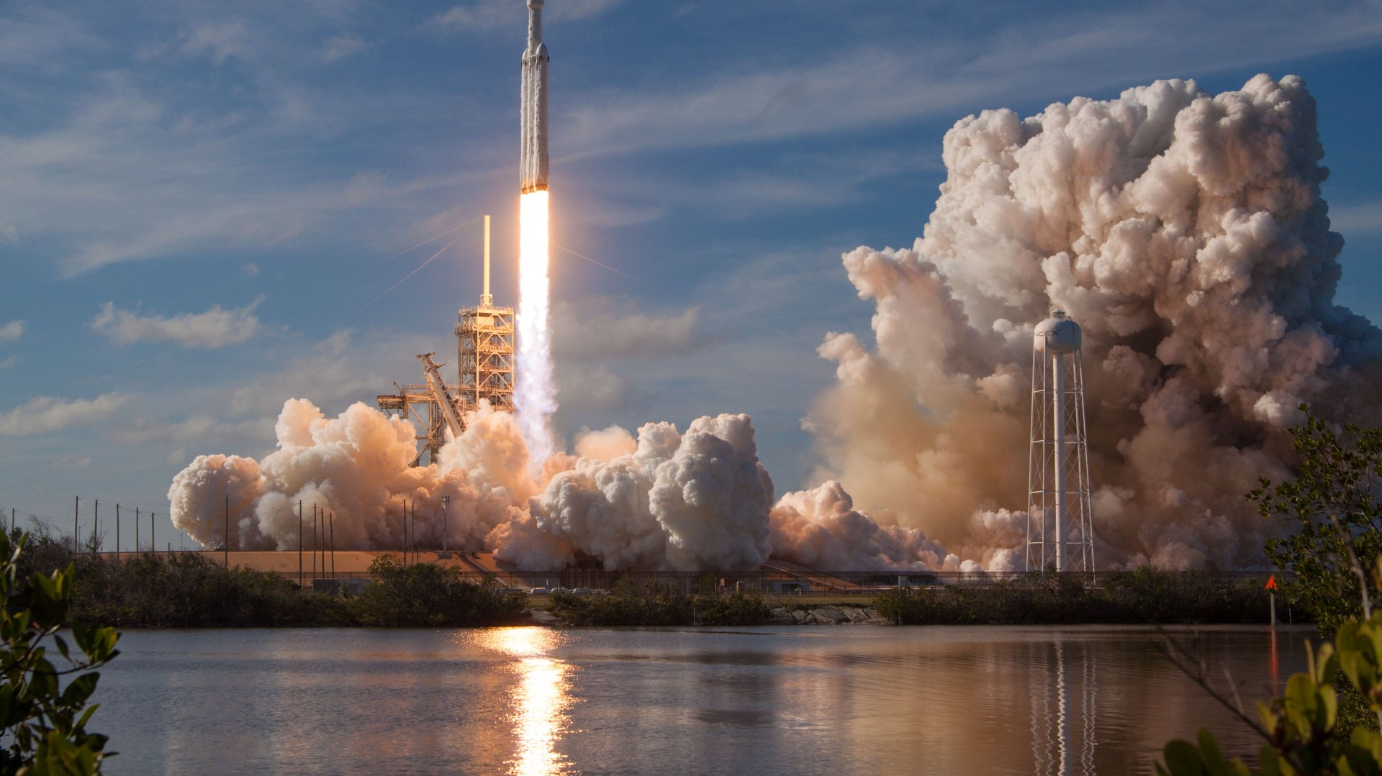
Results

Slide 16
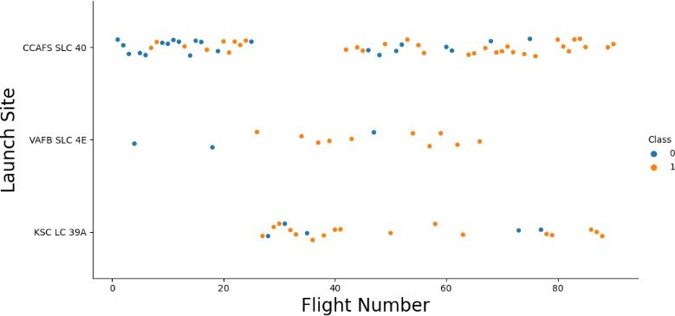
Flight Number vs. Launch Site
Earlier flights (blue) had a lower success rate
Later flights (orange) show a higher success rate
Nearly 50% of launches were from CCAFS SLC 40
VAFB SLC 4E and KSC LC 39A had better success rates
Indicates that SpaceX's launch success improved over time

Slide 17
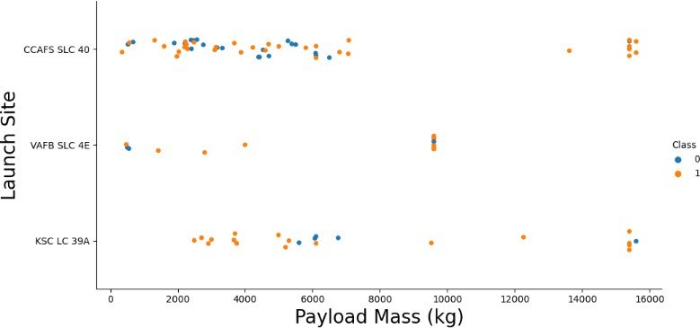
Payload vs. Launch Site
Higher payloads tend to have higher success rates
Launches with payloads over 7,000 kg were mostly successful
KSC LC-39A achieved 100% success for payloads below 5,500 kg
VAFB SLC-4E has not launched payloads above ~10,000 kg

Slide 18
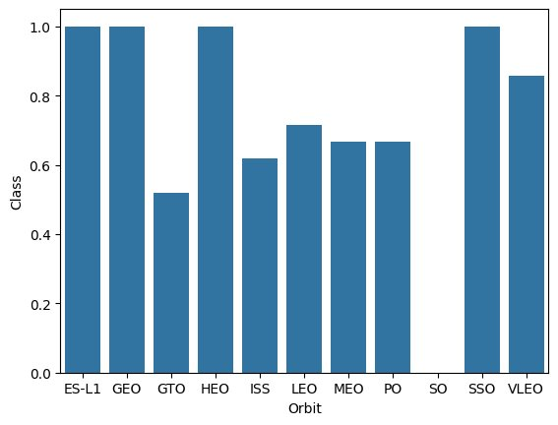
Success Rate by Orbit
ES-L1, GEO, HEO, and SSO achieved a 100% launch success rate
GTO, ISS, LEO, MEO, and PO had lower success rates, ranging from 50% to 70%
This highlights a clear performance gap between orbits with consistent reliability vs. those with variable outcomes

Slide 19
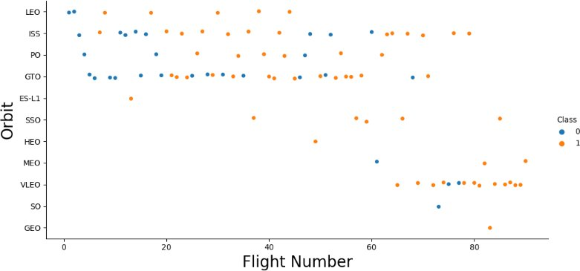
Flight Number vs. Orbit
When the flight number increases, the success rate increases as well.
For example, from flight number 60 till the end, only around 5 failures were found.
While flight numbers from 0-20, there are more failures than successes.

Slide 20
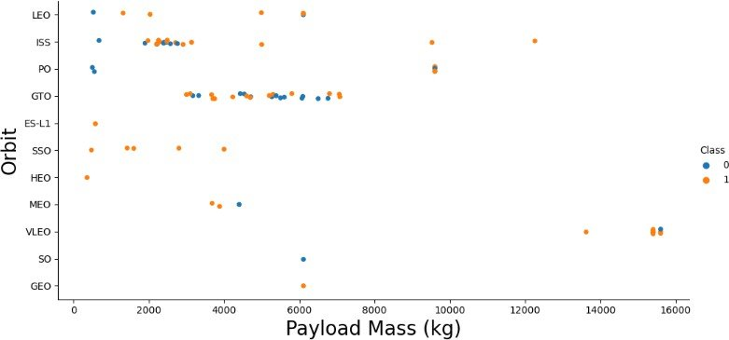
Payload vs. Orbit
GTO shows the lowest success rate, likely due to its high payload demands
Failures occur across all payload ranges, indicating no strong correlation between payload mass and success rate

Slide 21
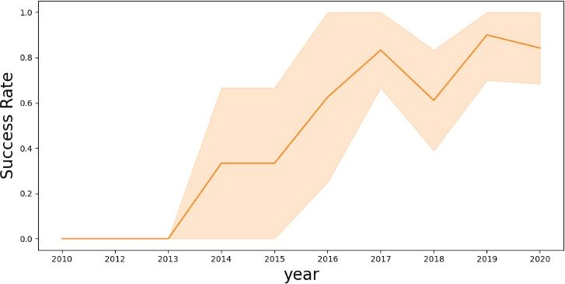
Launch Success over Time
Success rate was 0% between 2010 and 2013
Sharp increase from 2013 to 2017, reaching ~80%
From 2017 to 2020, success rate fluctuated between 60% and 90%
Overall trend shows a significant improvement in launch success over time

Slide 22
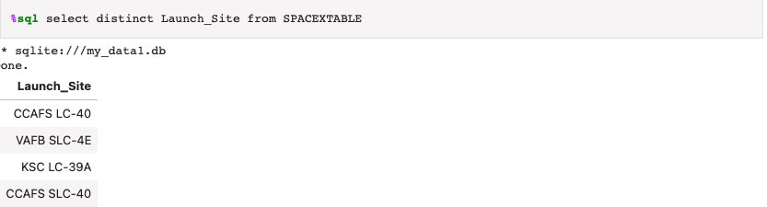
Lauch Site Info
Used ”distinct” query to extract the unique value from the columns “Launch_Site” from dataset SPACEXTABLE

Slide 23
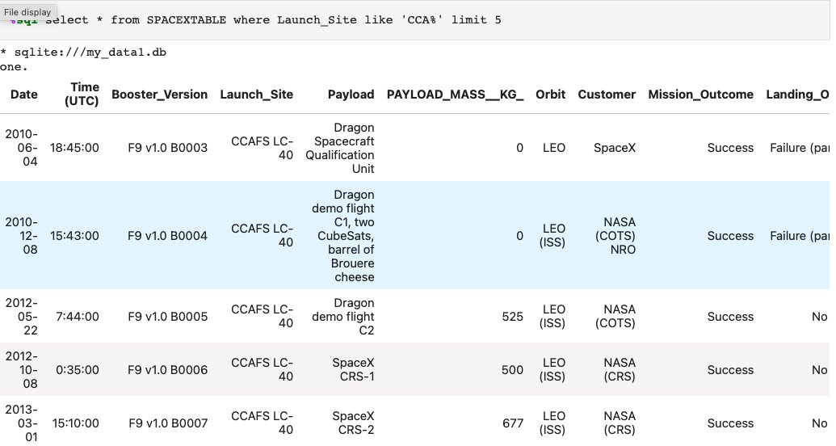
Launch Site Names Begin with 'CCA'
Used like “CCA%” that starts with CCA and limits 5 to present only the first 5 results.

Slide 24
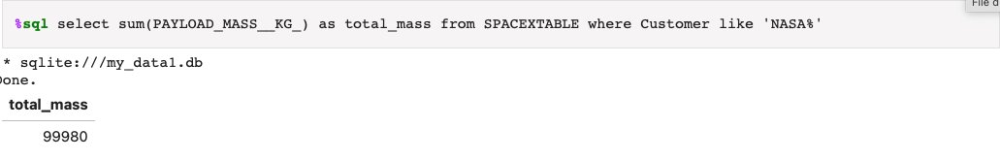
Total Payload Mass
Used SUM(PAYLOAD_MASS) to calculate total payload mass
Renamed the result as total_mass using AS
Filtered records where customer name starts with 'NASA' using LIKE 'NASA%'

Slide 25
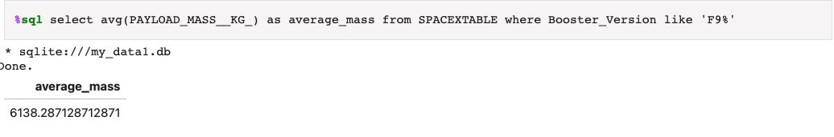
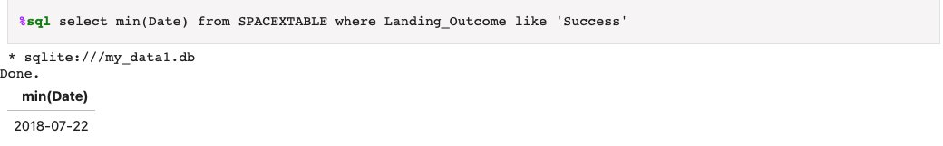
Payload Mass
First Successful Ground Landing Date
Found the first successful ground pad landing date using MIN(Date)
Filtered Landing_Outcome with LIKE 'Success%' to identify the earliest success
Average Payload Mass
2,928 kg (average) carried by booster version F9 v1.1

Slide 26
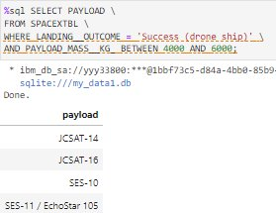
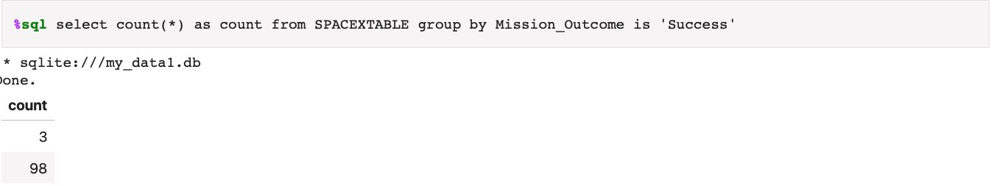
Successful Drone Ship Landing with Payload between 4000 and 6000
Total Number of Successful and Failure Mission Outcomes
Counted successful vs. failed launches using COUNT(*) grouped by Mission_Outcome
Helped assess launch reliability and identify success trends over time
Listed the names of boosters which have successfully landed on drone ship and had payload mass greater than 4000 but less than 6000

Slide 27
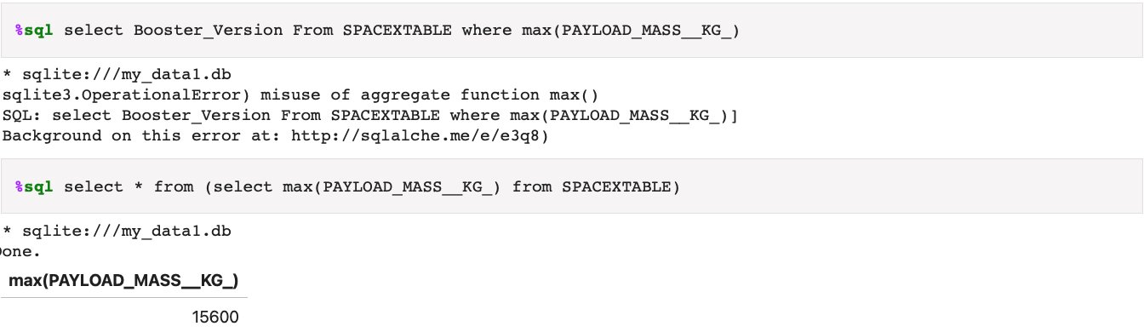
Boosters Carried Maximum Payload
Identified the Booster Version that carried the maximum payload mass
Used SQL to extract the record with the highest value in PAYLOAD_MASS_KG_
Retrieved and displayed the corresponding Booster Name

Slide 28
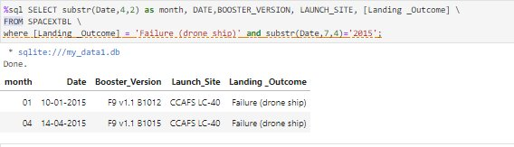
Failed Landings on Drone Ship
Extracted failed landings on drone ships during 2015
Retrieved Booster Version, Launch Site, and Landing Outcome
Used LIKE to filter rows where: ‣ Date contains '2015' ‣ Landing_Outcome includes 'failure'
Extracted Year and labeled outcomes as failure_Landing_Outcome for clarity

Slide 29
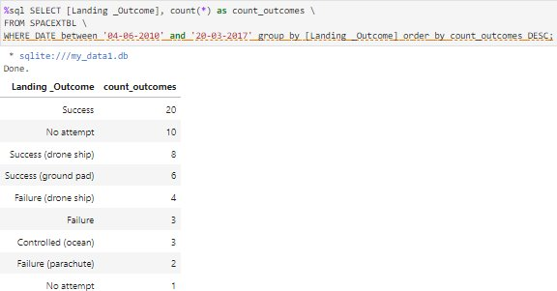
Count of Successful Landings
Counted each type of Landing_Outcome between 2010-06-04 and 2017-03-20
Used GROUP BY to aggregate unique landing outcomes
Applied ORDER BY to rank results in descending order
Highlighted most frequent outcomes like "Success (ground pad)" and "Failure (drone ship)"

Slide 30
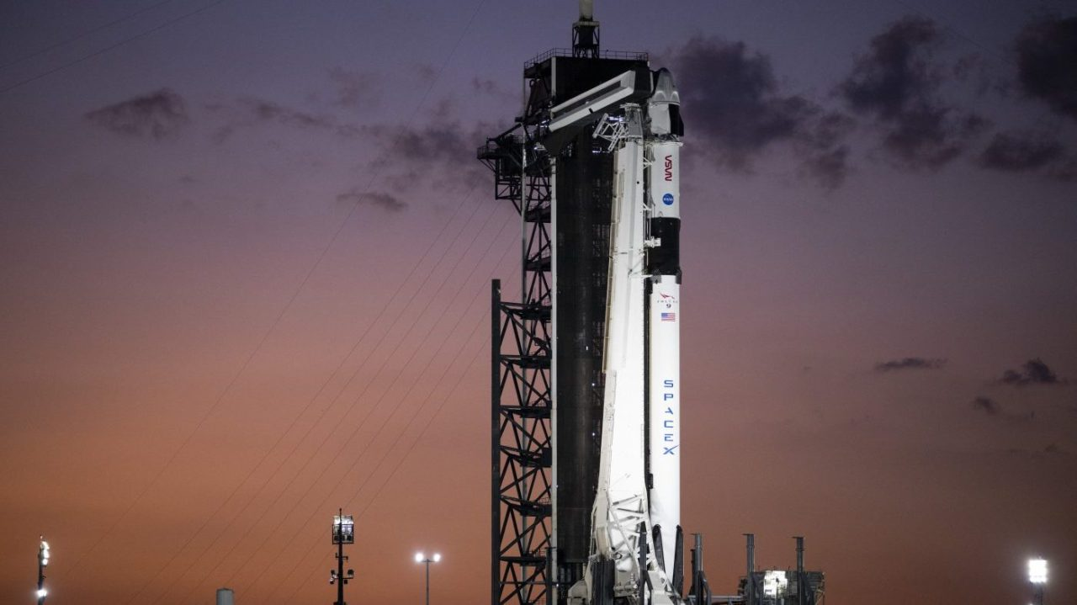
Lauch Site Analysis

Slide 31
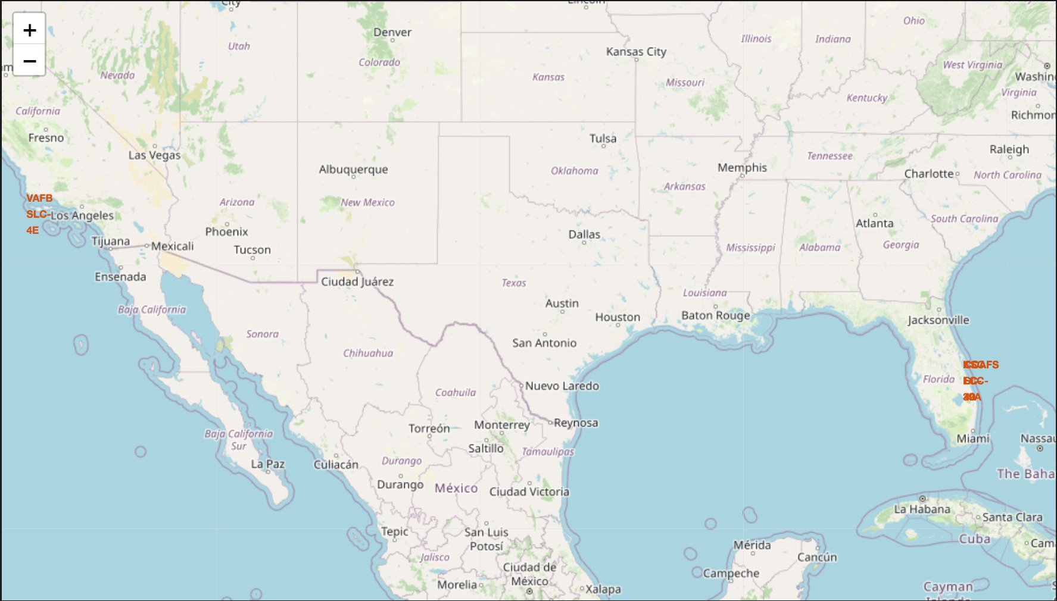
Launch Sites with Markers
Launch sites near the equator benefit from Earth’s rotational speed
This provides a natural velocity boost for prograde orbits
Reduces fuel and booster requirements, making launches more efficient and cost-effective

Slide 32
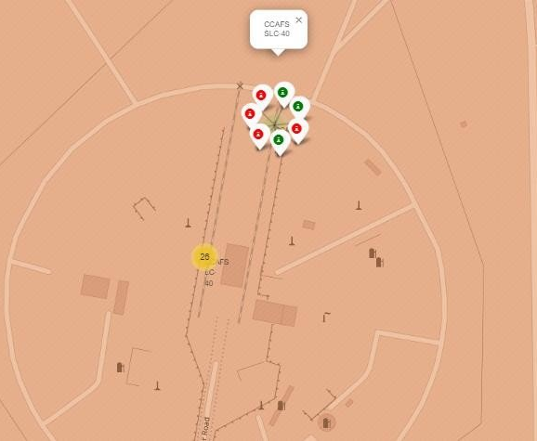
Color Labeled Lauch Sites
Green markers indicate successful launches
Red markers indicate unsuccessful launches
At CCAFS SLC-40, the success rate is 3 out of 7 launches → 42.9%

Slide 33
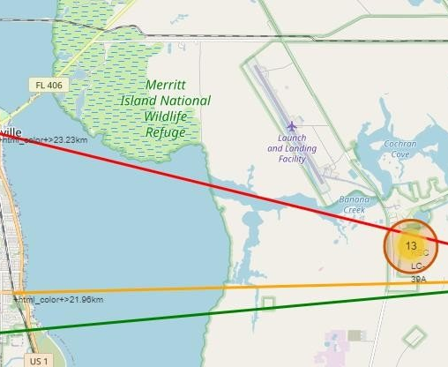
Distance to Proximities
Launch site is close to railway, highway, and coastline for easy logistics
Southern line points to the nearest city, ensuring a safe buffer distance
Placement reflects strategic planning for accessibility and safety

Slide 34
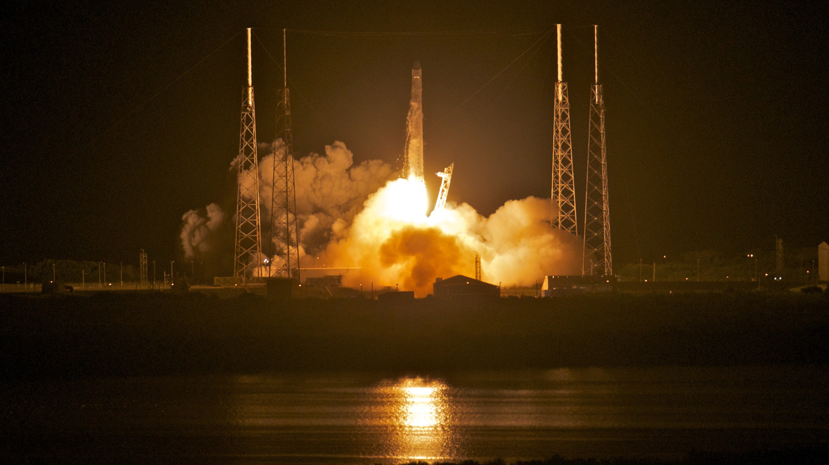
Dashboards with Plotly

Slide 35
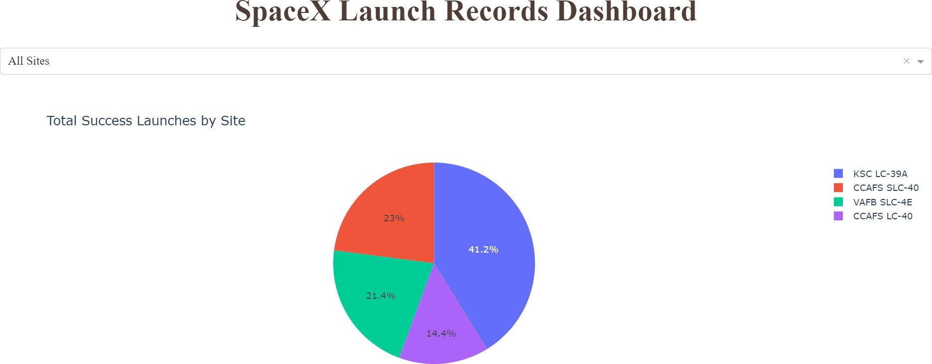
Launch Success by Site
KSC LC-39A stands out as the top-performing launch site, contributing to 41.2% of all successful missions
This high success rate highlights operational reliability and mission-critical capabilities of the site
Its strong track record reinforces SpaceX’s preference for KSC LC-39A in executing high-stakes launches

Slide 36
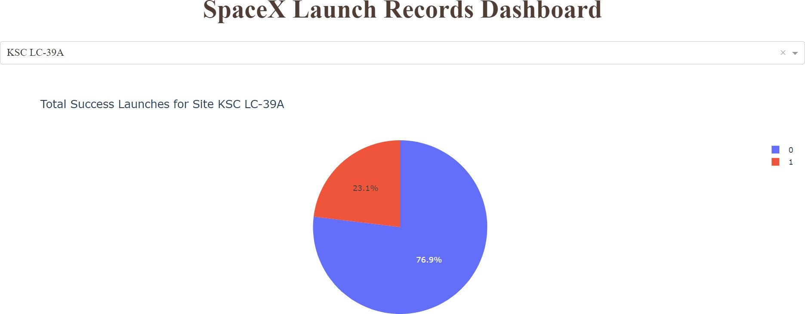
Launch Success for (KSC LC-29A)
KSC LC-39A holds the highest success rate among all launch sites at 76.9%
Out of 13 total launches, 10 were successful and only 3 ended in failure
This highlights KSC LC-39A's strong reliability and role in SpaceX’s most successful missions

Slide 37
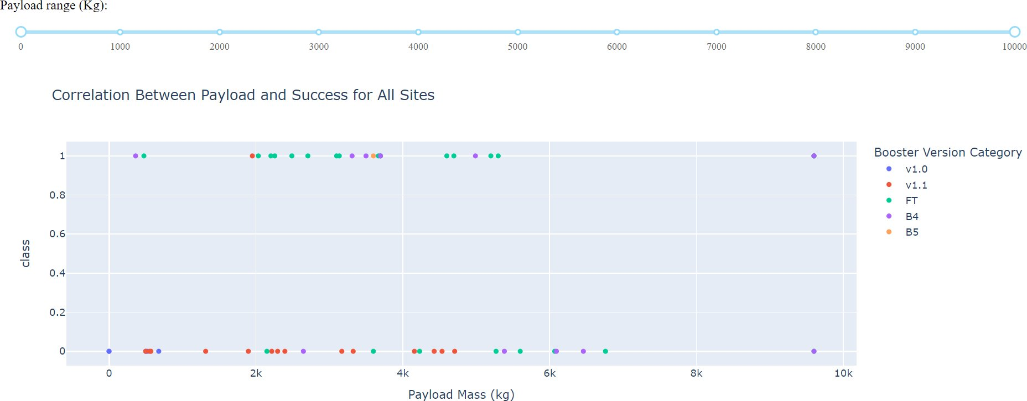
Success Rate by Booster Version and Payload Range
Boosters carrying payloads between 2,000 kg and 5,000 kg show the highest success rate
Outcomes are encoded as: ‣ 1 = Successful ‣ 0 = Unsuccessful
Indicates an optimal payload range for maximizing mission success

Slide 38
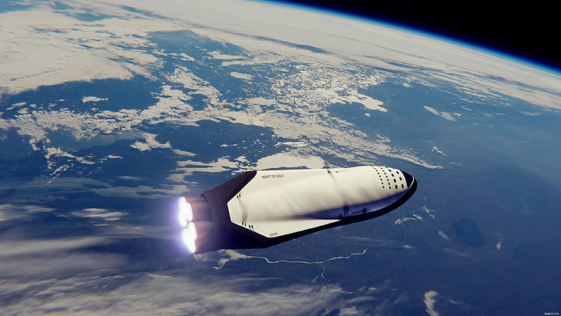
Predictive Analysis

Slide 39
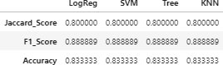
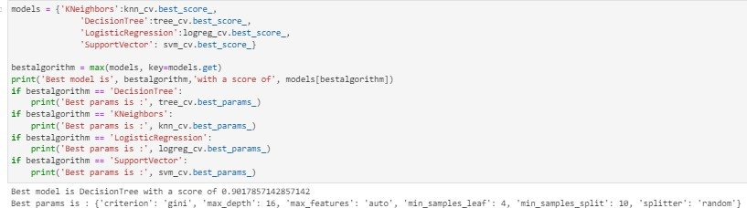
Classification Accuracy
Model Accuracy and Performance Comparison
All models achieved similar accuracy and scores, likely due to the limited dataset size
Decision Tree performed slightly better based on .best_score_
.best_score_ represents the average accuracy across all cross-validation folds for each parameter set
Highlights the need for more data to better distinguish model performance

Slide 40
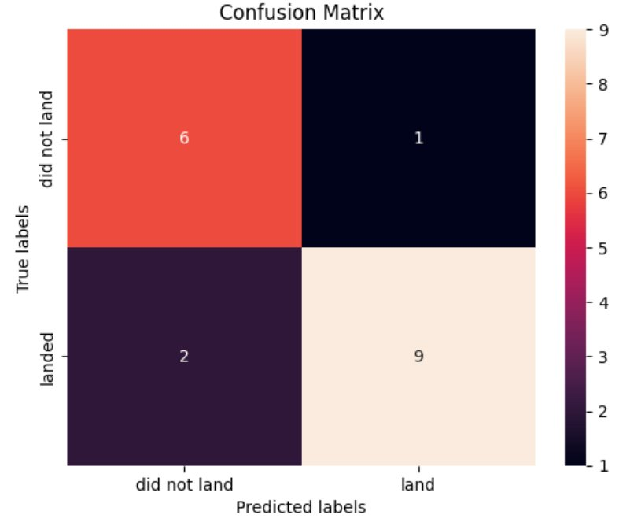
Confusion Matrix – Decision Tree Model
The matrix compares true labels vs. predicted labels
Shows that most predictions correctly classified both “Landed” and “Did Not Land” outcomes
Correct classifications significantly outnumber mismatches
Indicates that the Decision Tree model is reliable for predicting landing success based on available features

Slide 41
Conclusion
Launch success improves over time, strongly correlated with Flight Number
Other factors like orbit type, payload mass, and launch site show limited or no strong correlation to success
Decision Tree model delivered the best predictive accuracy, as confirmed by the confusion matrix
KSC LC-39A stands out with the highest success rate, especially for payloads under 5,500 kg
Orbits such as ES-L1, GEO, HEO, and SSO have shown 100% success rates
Higher payload mass often correlates with higher success, across multiple launch sites
Launch sites near the equator and coastline benefit from Earth’s rotation and geographic advantage, improving fuel efficiency and launch stability

Slide 42
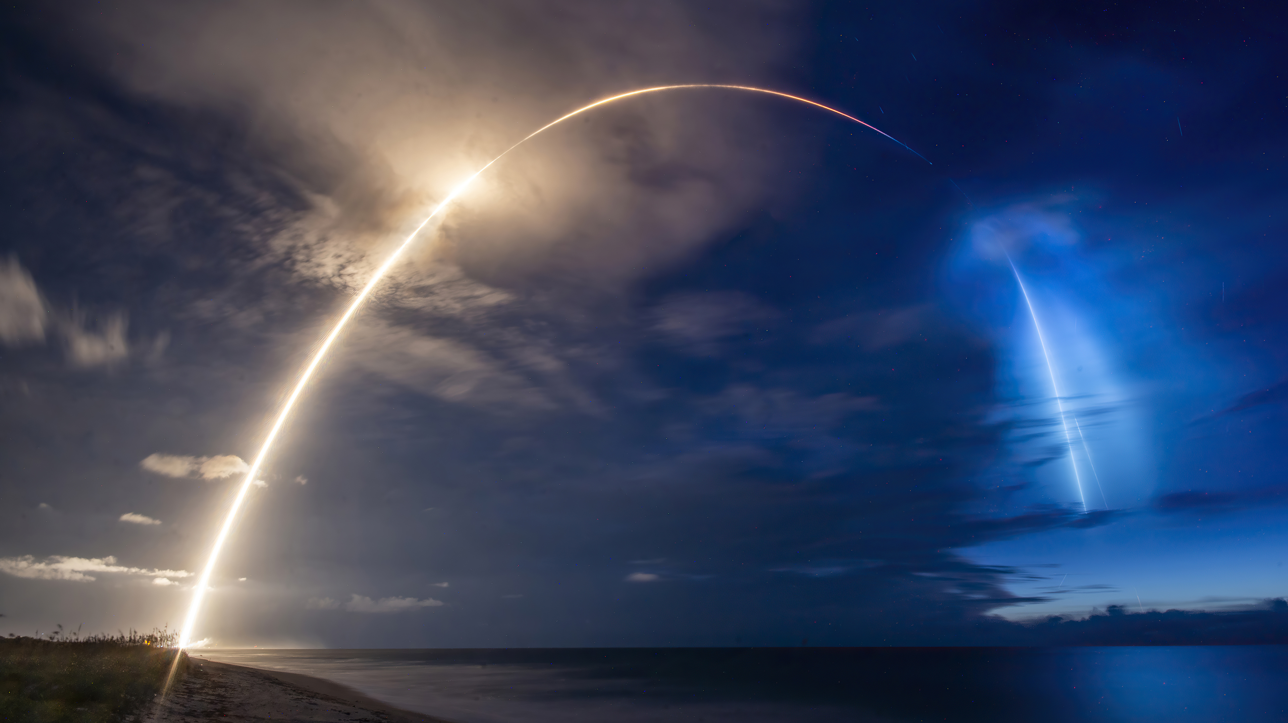
Thank You

